Slide 1
Quasar Spectra Analysis
Chenliang Su
Guozhen Ma
Miao Shang
Sachin Wong
14/06/2023
Applied Machine Learning 2023

Slide 2
Outline
Tensorflow regressor to predict the quasar redshifts
Gated Recurrent Unit (GRU) to predict redshifts
CNN to classify whether DLAs (Damped Lyman-alpha absorber) appear
CNN to locate where DLAs are

Slide 3
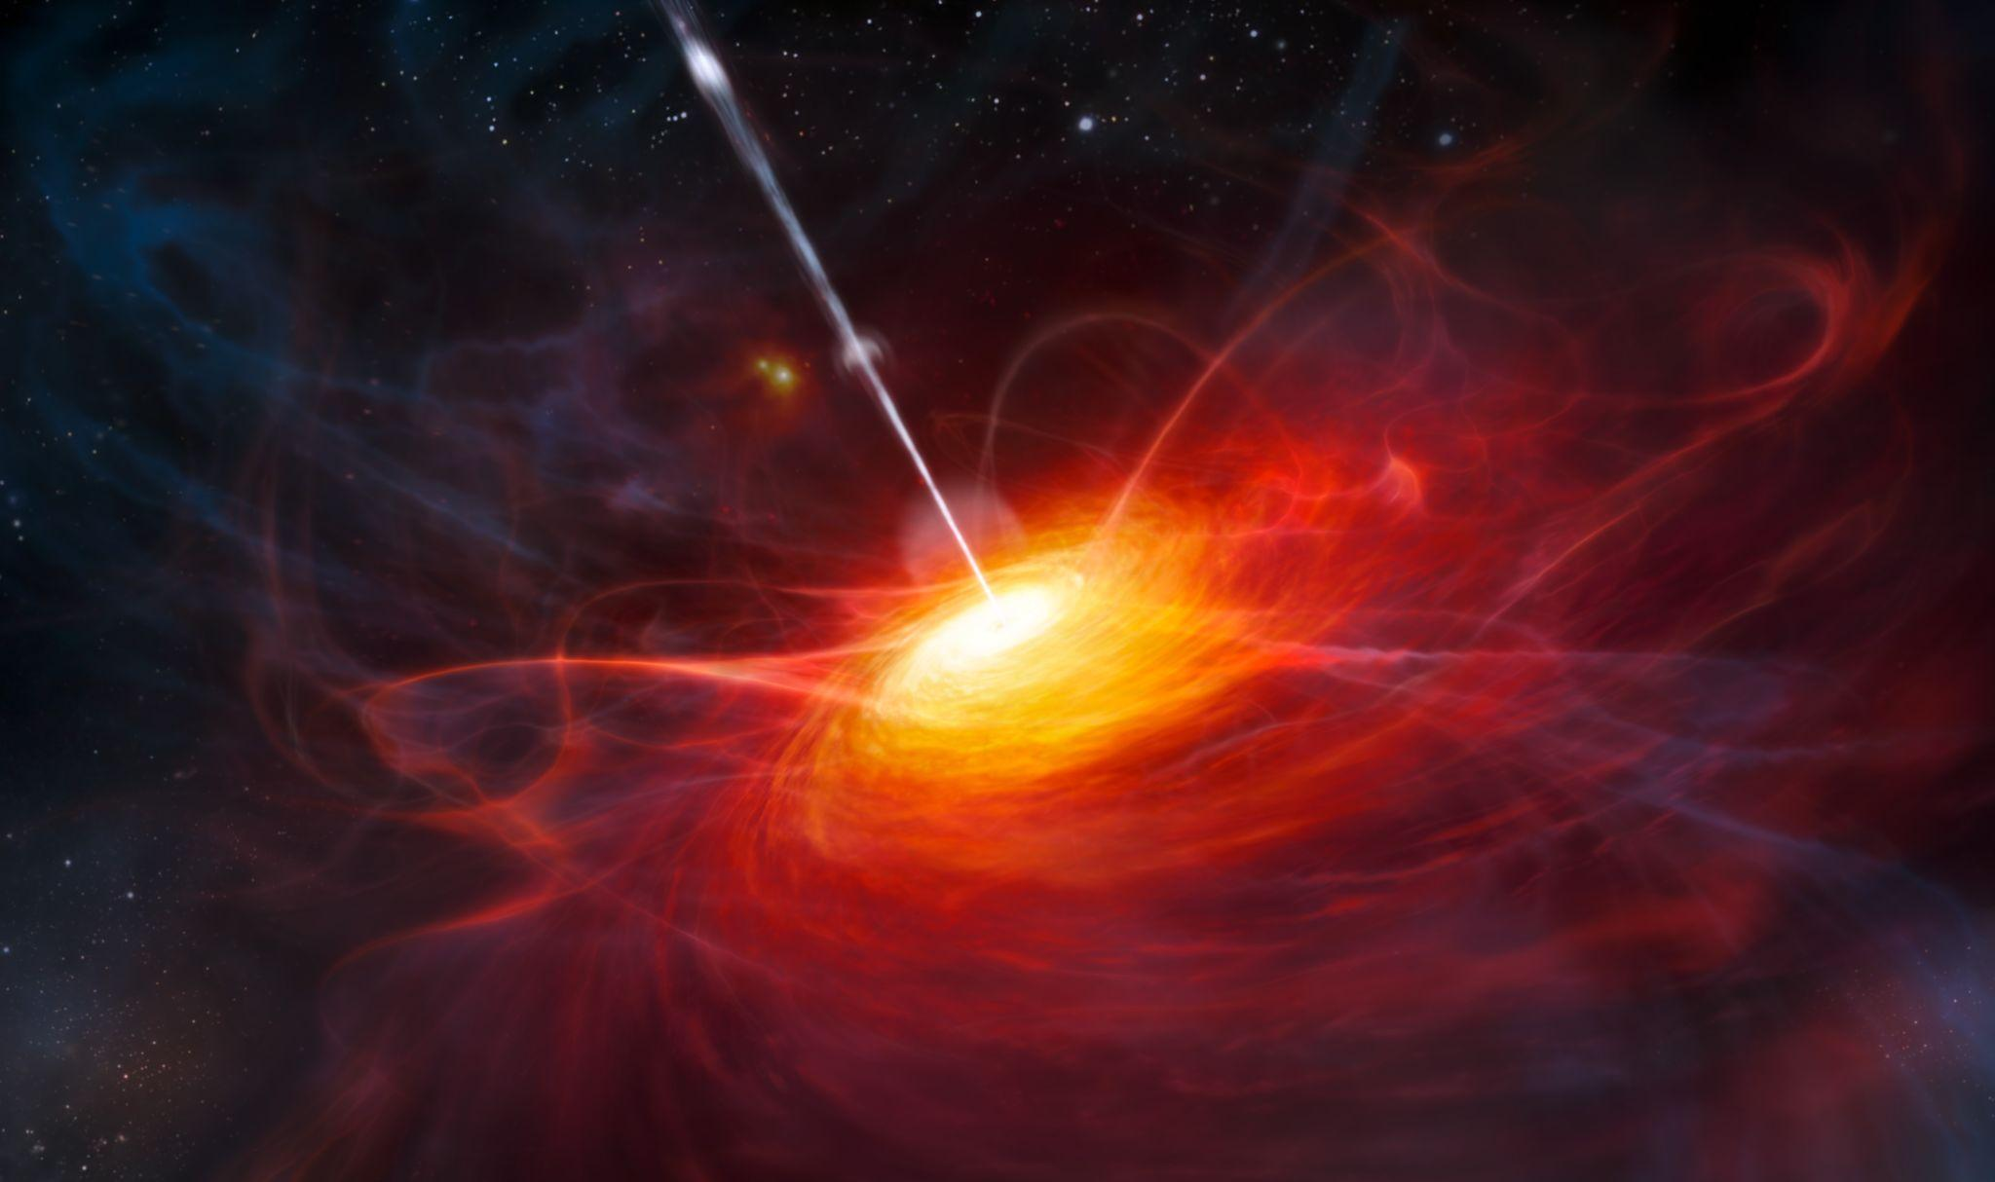
Background
Quasar, also known as QSO
(quasi-stellar object)
A kind of extremely luminous active galactic nucleus (AGN)
Supermassive black hole
The nearest known one is about 600 million light-years away from Earth.
Markarian 231 (UGC 8058)
Source: Wikipedia

Slide 4
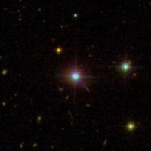
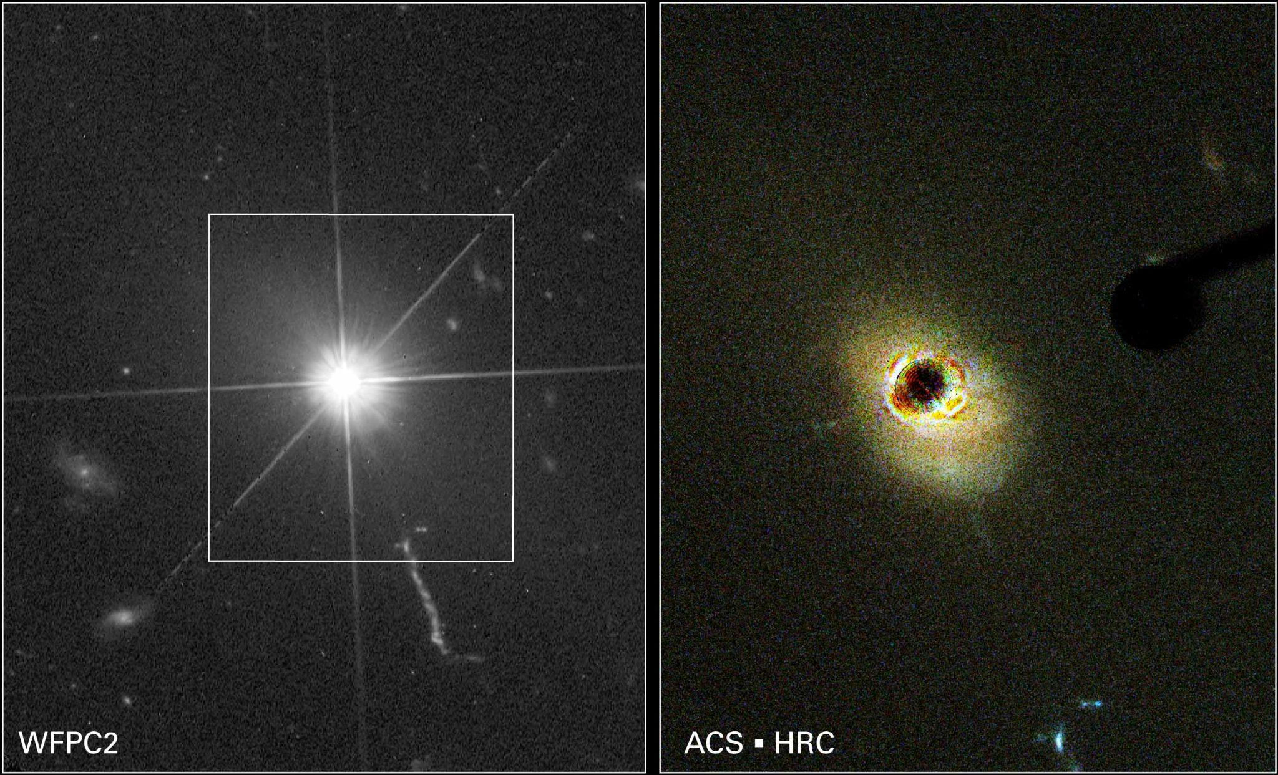
Background - imaging
Source: Wikipedia
3C 273

Slide 5
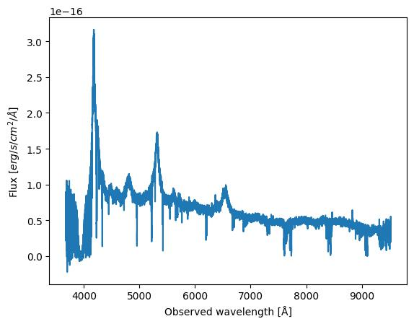
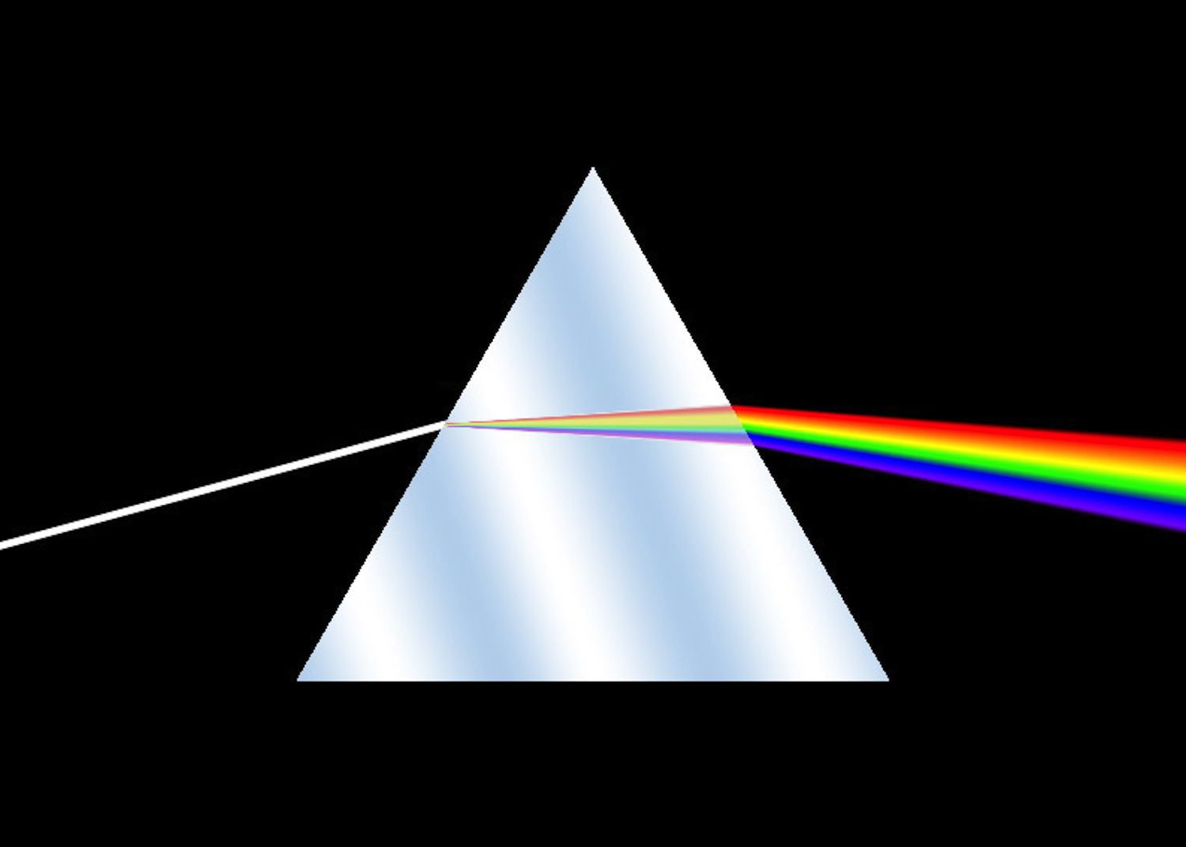
Background - spectroscopy
Dispersion
Source: https://www.thoughtco.com/introduction-to-spectroscopy-603741

Slide 6
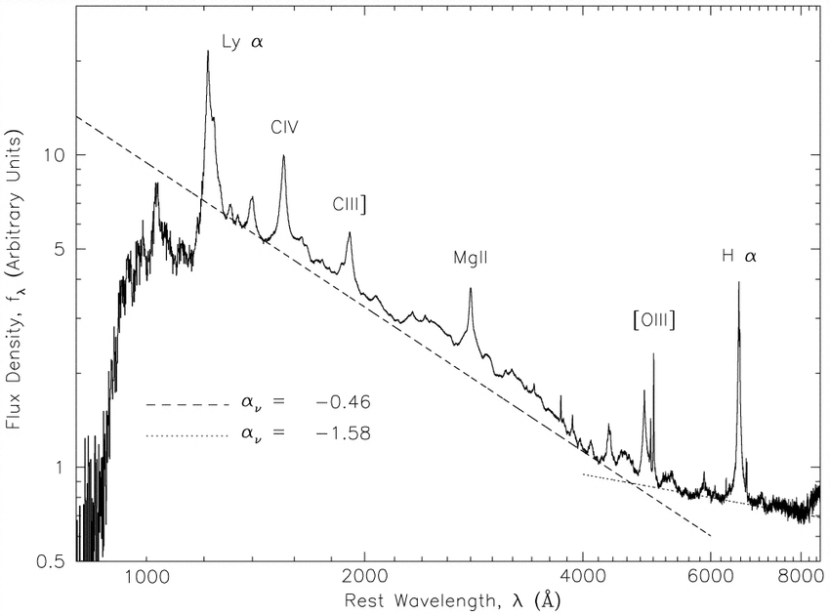
Background - redshift (z)
z = λ_obsv / λ_rest - 1
Source: Vanden Berk et al. (2001).

Slide 7
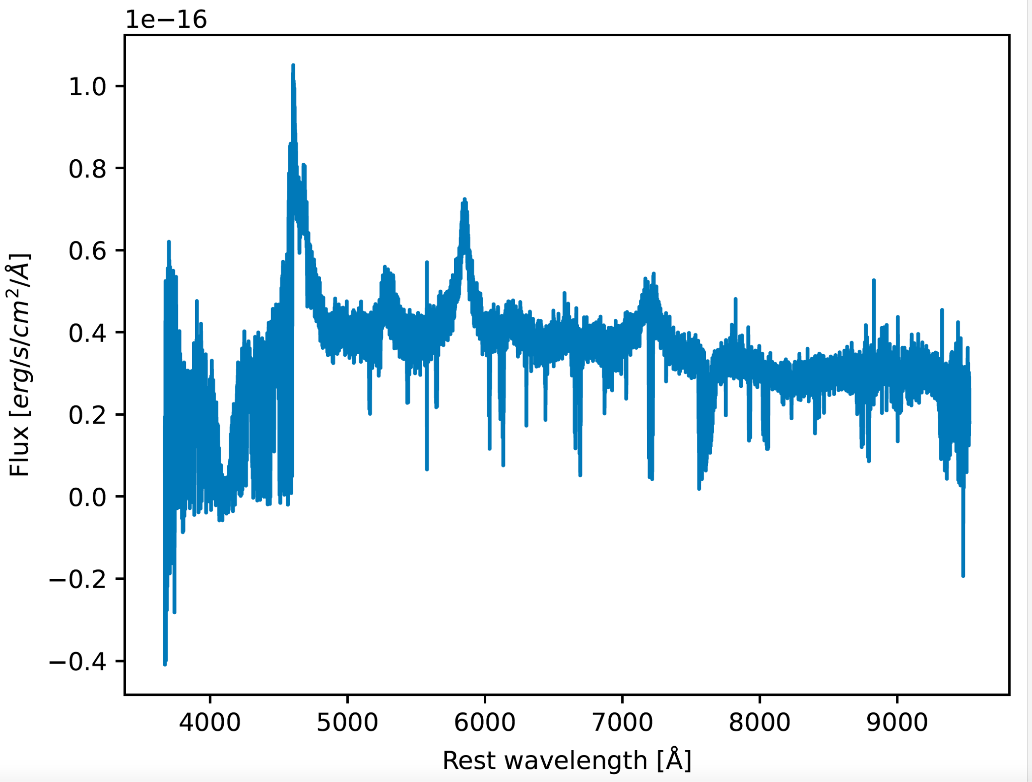
Motivation
4MOST - (4G–PAQS) - The survey will observe nearly 250,000 quasar candidates

Slide 8
Randomly simulated data
Z_range ∈ [2,4], Mag_range ∈ [18, 20.5]
Data size: 10000 spectra (~ 20 hrs for generation)
Data shape: (10000, 23411, 1) - (N_spec, N_wav_bins, input_features - Flux)
Simulator from Jens-Kristian Krogager, Astrophysics Research Center of Lyon
Wavelength range: 3600 ~ 9600 Å

Slide 9
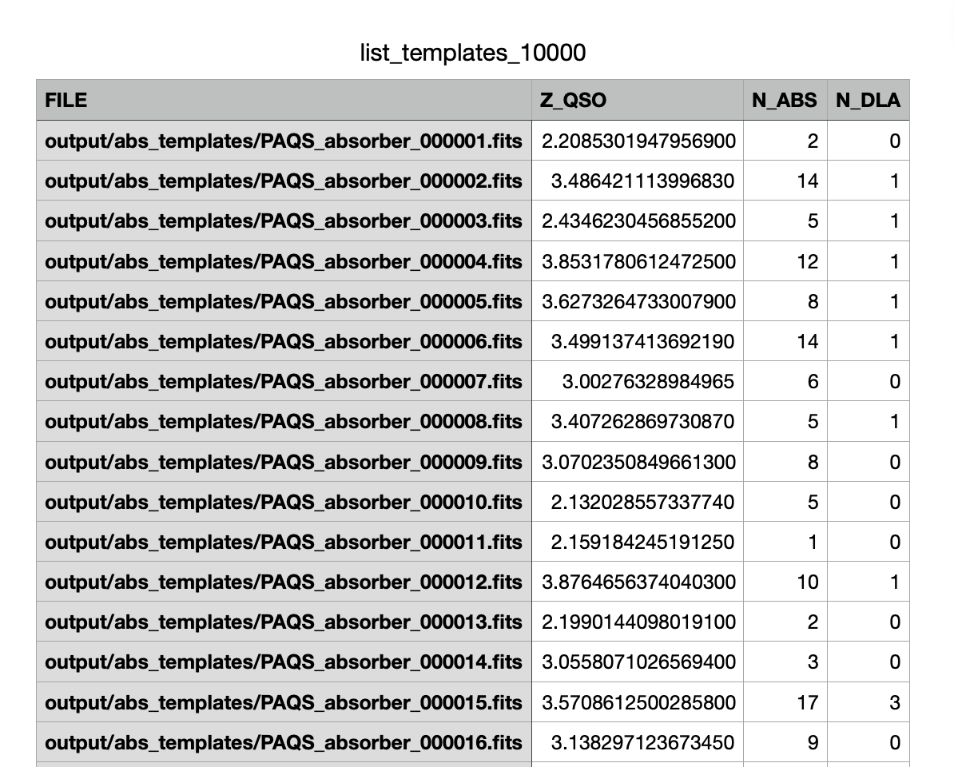
Labels/Truth

Slide 10
Finding the redshift(z) - TensorFlow regressor
The simplest idea - calculate redshift by a certain peak
λ_SiIV_rest
λ_SiIV_obsv
z = λ_SiIV_obsv / λ_SiIV_rest -1
Source: Vanden Berk et al. (2001).

Slide 11
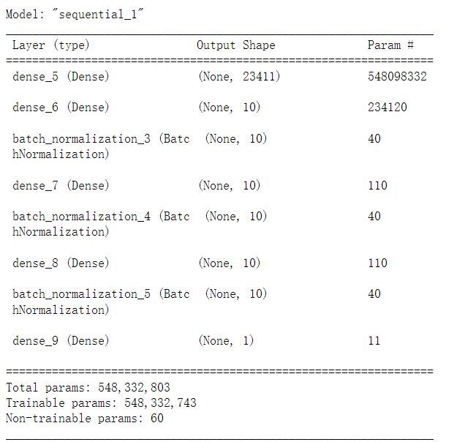
The part that is not simple - how do we know which peak is SiIV?
λ_SiIV_obsv ≈ 5300
λ_SiIV_obsv ≈ 4800
We human - compare neighboring peaks by eyes…
Or…let Regressor figure out its own way!
Model structure:
Learning rate determined by Adam optimizer
n_epochs = 8 batch_size = 50 n_samples=10000

Slide 12
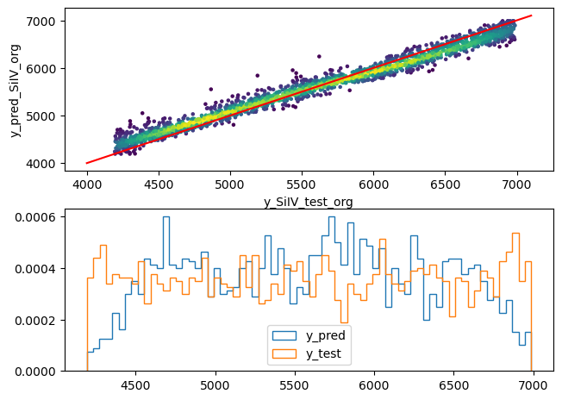
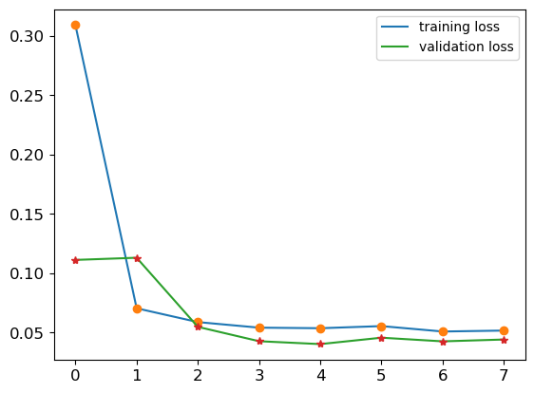
Results & Evaluation
Loss history* (mean absolute error)
Time used: 6775.952 s (failed to use GPU)
* Data is normalized by qt.transform

Slide 13
Results & Evaluation
It is a very simple ML model, but shows not bad accuracy
What are bad?
Loss remains unchanged in the last several epochs
It tends to predict higher values in small redshift, and lower values in large redshift
So it performs badly near the end points of the redshift range
Too long training time (~2 hours)

Slide 14
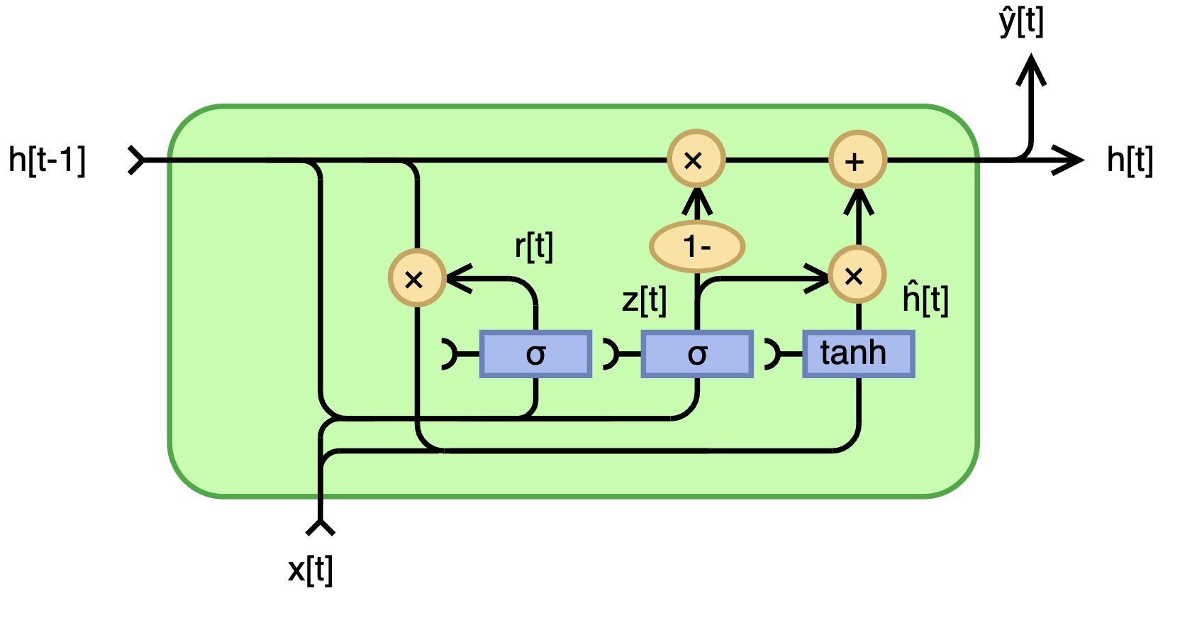
RNN - Gated Recurrent Unit (GRU) - Tensorflow
Predicted redshift
loss='mean
_absolute
_percentage
_error'
Activation('relu')
Dropout(0.2)
Dense(units=1)
Activation('linear')
units=100, input_shape=(23411, 1)
batch_size = 16,
epochs = 25, (+25+7)
with GPU acceleration thanks to Colab

Slide 15
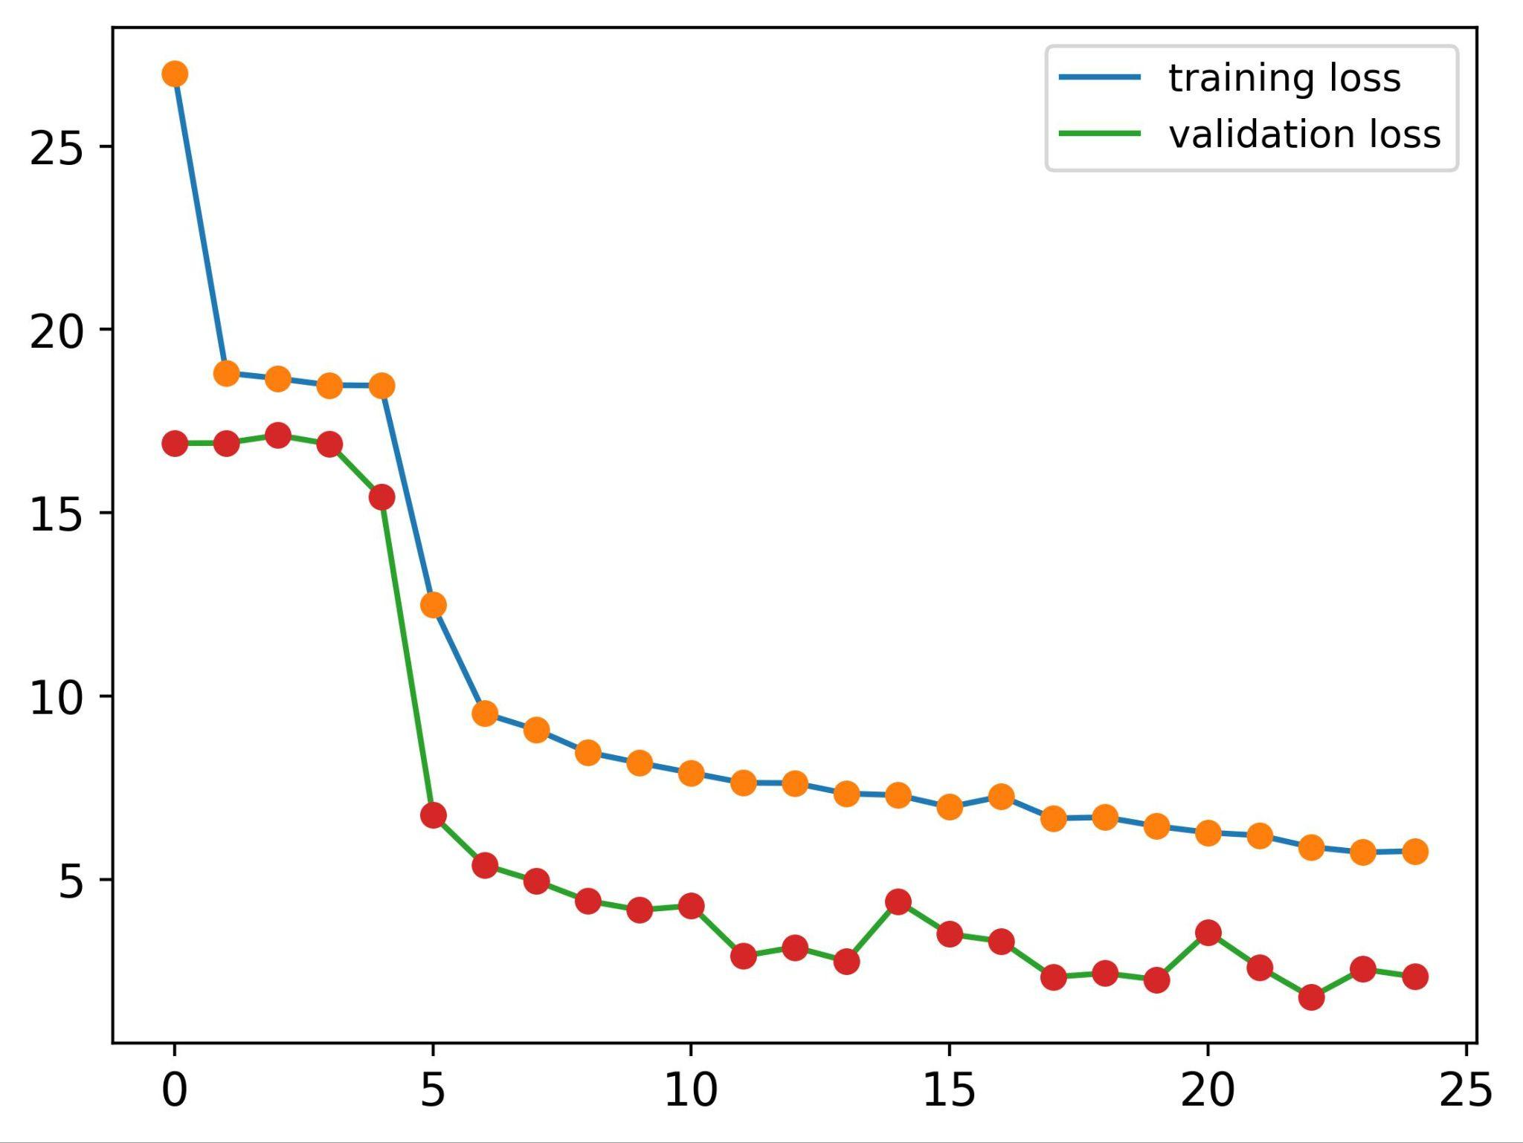
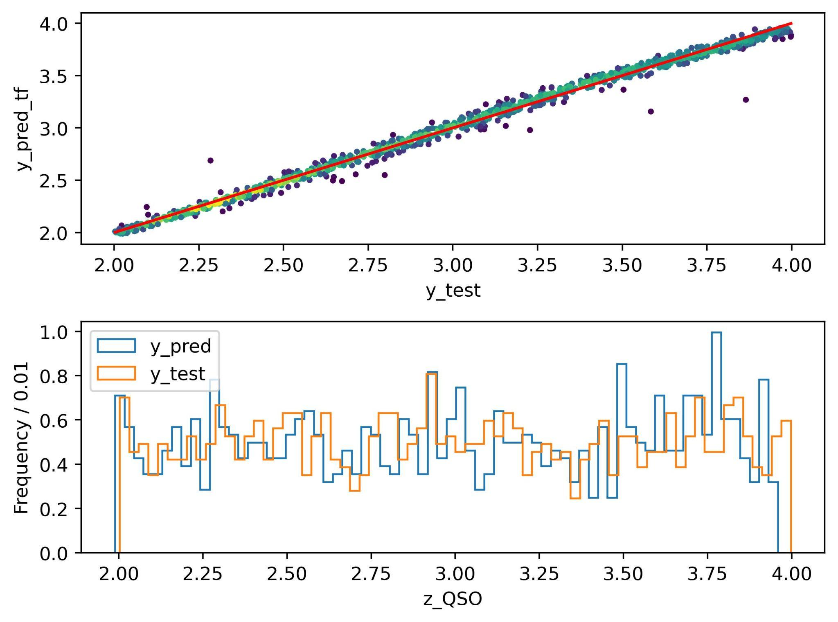
RNN - Gated Recurrent Unit (GRU) - Tensorflow
Loss
N_epochs
Test loss: 1.14%;
Time used by TensorFlow: 7547.7 s

Slide 16
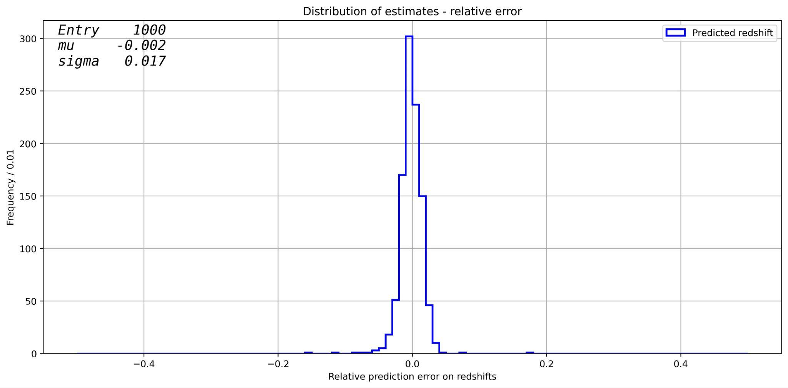
RNN - Gated Recurrent Unit (GRU) - Tensorflow
Test loss: 1.14%;
Time used by TensorFlow: 7547.7 s

Slide 17
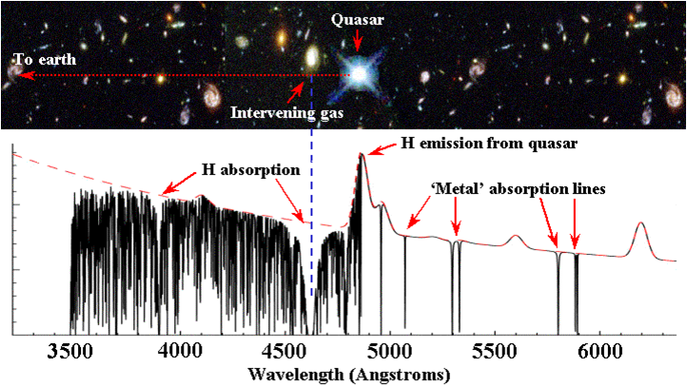
CNN - Classification - Tensorflow
What is DLA(Damped Lyman-alpha Absorbers)?
Why DLA?
Why CNN?
My work
Source: http://www.nat.vu.nl/~wimu/FundConst-Notes.html
Notes:
What is DLA?
Dlas are commonly observed in the spectra of distant quasars. They are characterized by strong absorption lines in the Lyman alpha region, caused by neutral hydrogen gas located along the line of sight between the quasar and the observer.
Why DLA?
By studying DLA systems, astronomers can investigate the abundance of neutral hydrogen, the distribution of gas in galaxies, and the processes involved in the formation and evolution of galaxies over cosmic time.
Why CNN?
Our work need to extract patterns and features of the spectra.

Slide 18
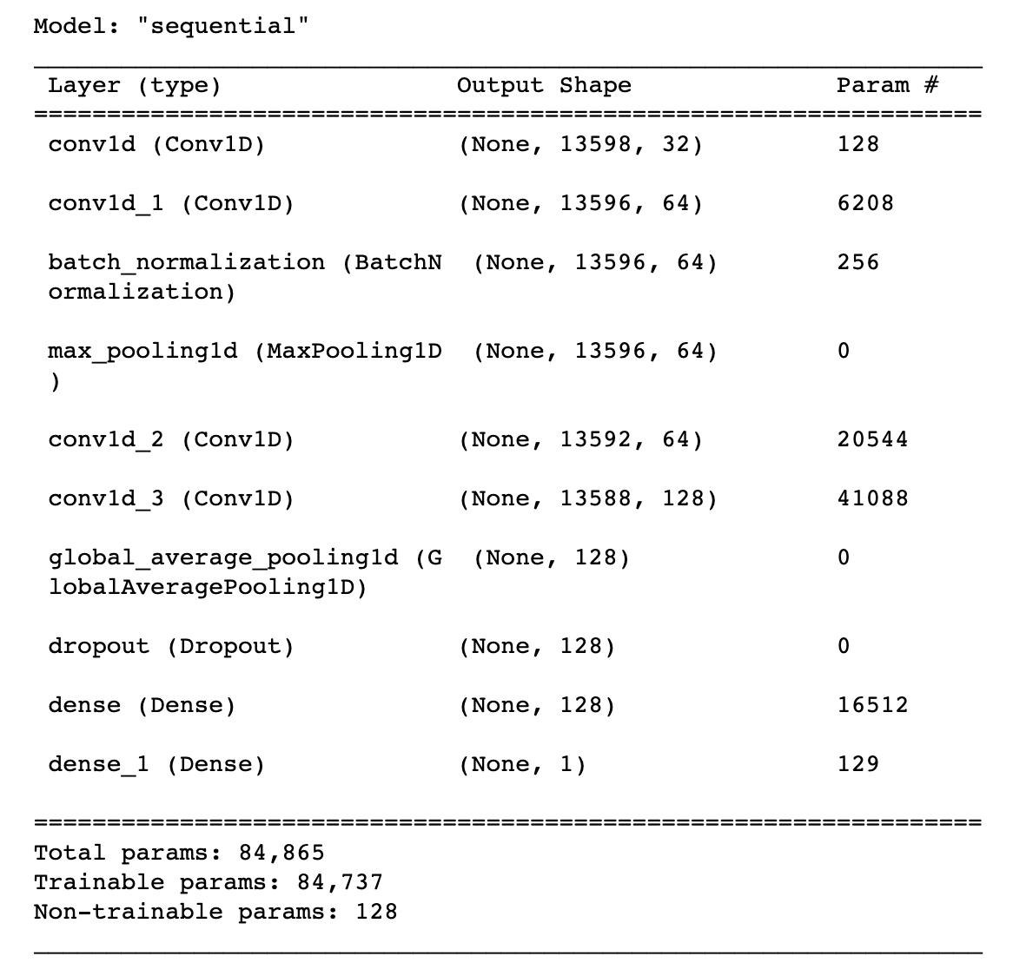
Notes:
My work is applying convolutional neural network on classification, if there exists DLAs.
Since we know the approximate value of redshift so we evaluated the probable wavelength boundaries which will reduce the size.
We used a fair number of layers and tested different filter number, since the spectra features are complicated, we need a relatively complex model.

Slide 19
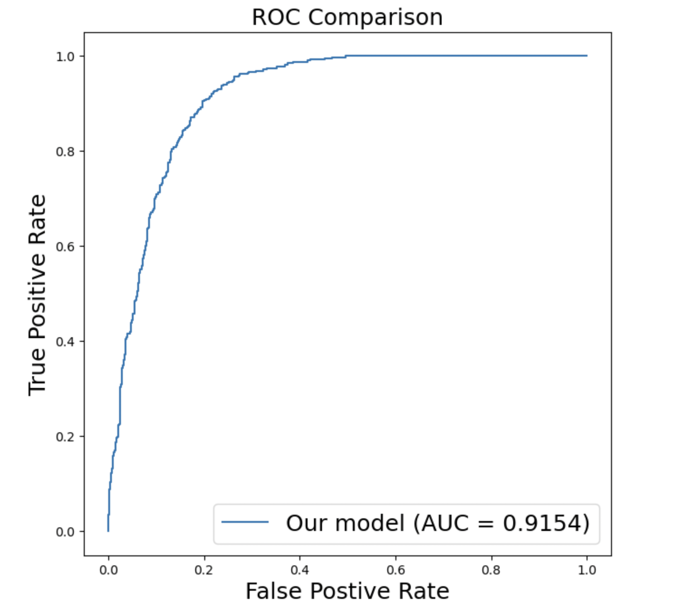

Slide 20
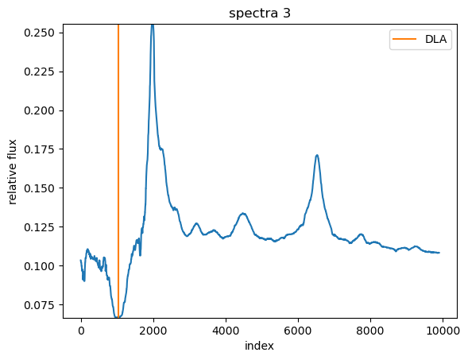
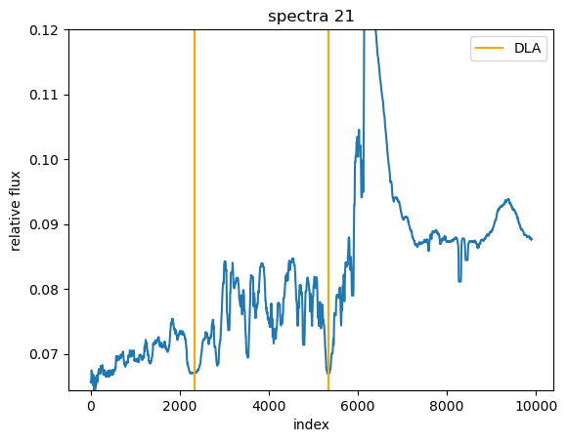
CNN - Locating Damped Lyman Alpha Absorptions
Notes:
We know the true location of the DLA absorptions from the absorption redshift
Aim is to find the location of these DLA absorptions so we can calculate the absorption redshift

Slide 21
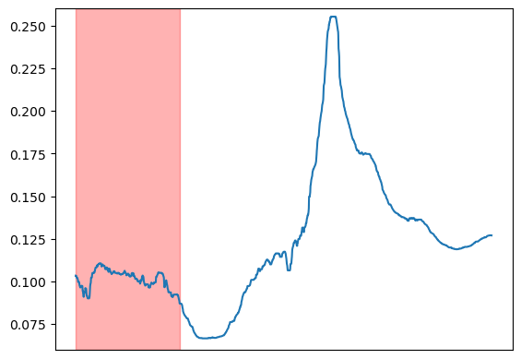
CNN - Preparing Data + Labels
Notes:
To do this, we needed to label where the DLA is in the spectra
Sliding window effect created by splitting each spectrum into overlapping segments
An area around the DLA location is labelled as “1” for each point, and for each segment, if there are a certain number of “1”s, the segment is labelled to have the DLA in it.

Slide 22
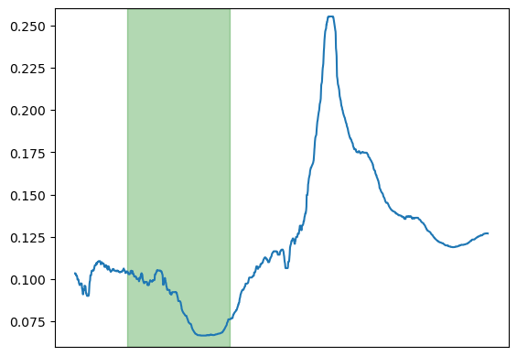
CNN - Preparing Data + Labels

Slide 23
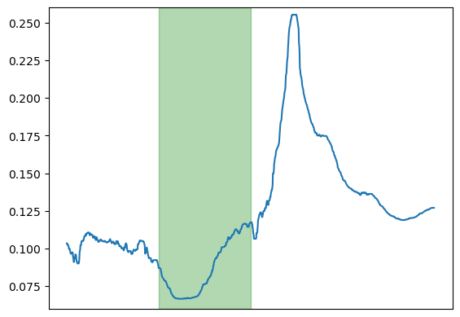
CNN - Preparing Data + Labels

Slide 24
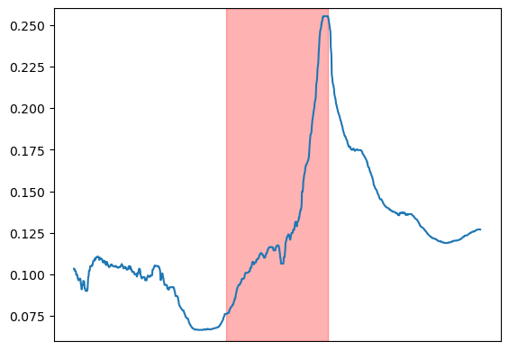
CNN - Preparing Data + Labels

Slide 25
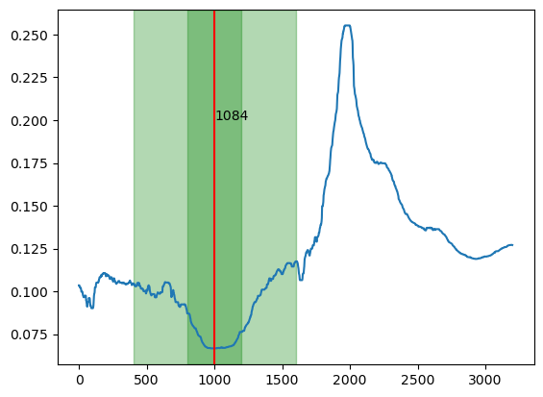
CNN - Locating Damped Lyman Alpha Absorptions

Slide 26
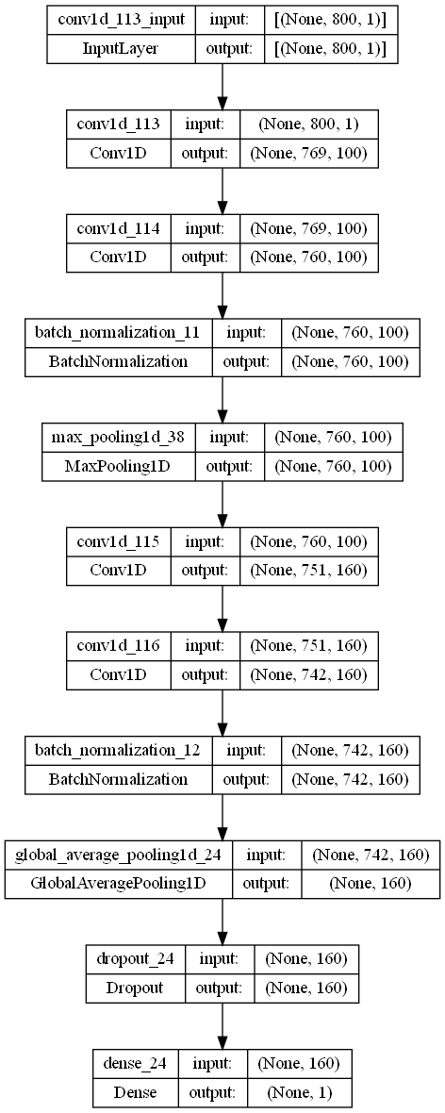
CNN Structure - Keras

Slide 27
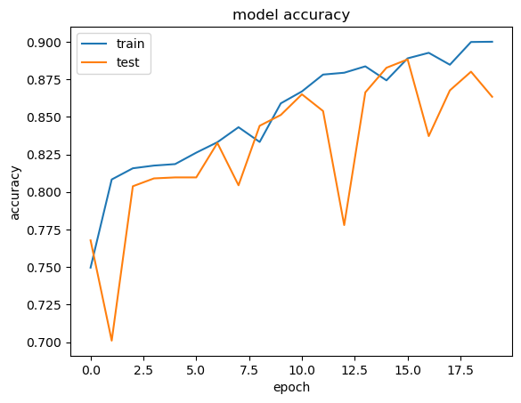
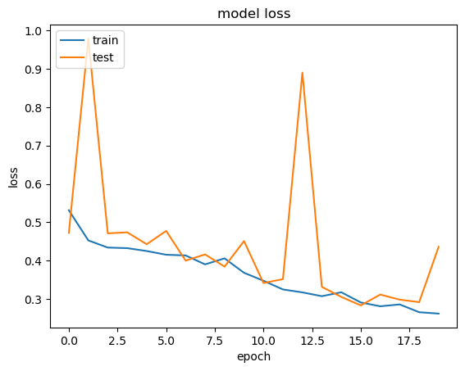
Results
Notes:
Remember to include evaluation of how the model performs!

Slide 28
Conclusion
Performance of our models
Tensorflow regressor: test loss = 0.0441
GRU: test loss = 1.14%
CNN for classifying DLAs: AUC = 0.9154
CNN for locating DLAs: accuracy ~ 90%
Did we reach our objective?
What could we improve?
Try to implement GPU acceleration on our own machine or get access to larger clusters.
More training data.

Slide 29
Thank you :)
Any questions?

Slide 30
Appendix

Slide 31
Appendix - TensorFlow Regressor
Features
Our samples are spectra, and the features are the flux of each spectrum. In each spectrum, the wavelength ranges from 3671.5 to 9524 and a wavelength bin is 0.25 wide, i.e. there are 23411 wavelength bins in each spectrum. So each sample has 23411 features (a very large parameter space).
Data preprocessing
Before qt.transform and training, I preprocess the truth data (the location of SiIV peak) by
y_truth = (λ_SiIV - 3671.5) / 0.25
The idea is that, we only input the flux data so the machine know nothing about the wavelength. Then it might be hard for it to learn how a wavelength value like 9524 jumps out. But the machine does know the label of flux, in other words, the label of wavelength bins. Hence, the above transformation convert 9524 to (9524 - 3671.5) / 0.25 = 23410 = the label of the last flux, something the machine should know.
Optimization
Due to the long training time I only try to optimize the batch size. It turns out that the smaller batch size gives better results.

Slide 32
Appendix - GRU
Reasons for choosing to use GRU:
Spectrum data is in series and it is very similar to time series data. The spectrum is a flux function with respect to wavelength, and every point is highly linked with the one before and after, so we immediately wanted to try to analyse the spectra with RNN. LSTM is better for analysing time series, so we choose to use GRU since the spectrum is not really time series.
GRU does not make use of the cell state and instead uses the hidden state to transfer information. It also only has two gates, a reset gate and update gate. GRUs have fewer tensor operations; therefore, they are a little speedier to train than LSTM.

Slide 33
Appendix - GRU
Hyper parameter optimization:
It seems that more units in GRU always help, but it also increase the code running time significantly. By considering both the performance of the code and the running time, we choose to use 100 in the end.
We add a drop-out layer after the GRU to avoid over-fitting.
A smaller batch-size is better, and it takes longer time, which is different from the common sense. (Batch-size gives the size of samples which is the amount of training samples to consider at a time for updating the network weights) - size = 32 -> Test loss: 3.68%, t: 1670s / size = 64 -> Test loss: 6.66%, t: 936 s.
We used a loss function of mean_absolute_percentage_error, since our true values are between 2 and 4 and the mean_absolute_error will be a too small value (0.02 or lower), so we chose the percentage error.

Slide 34
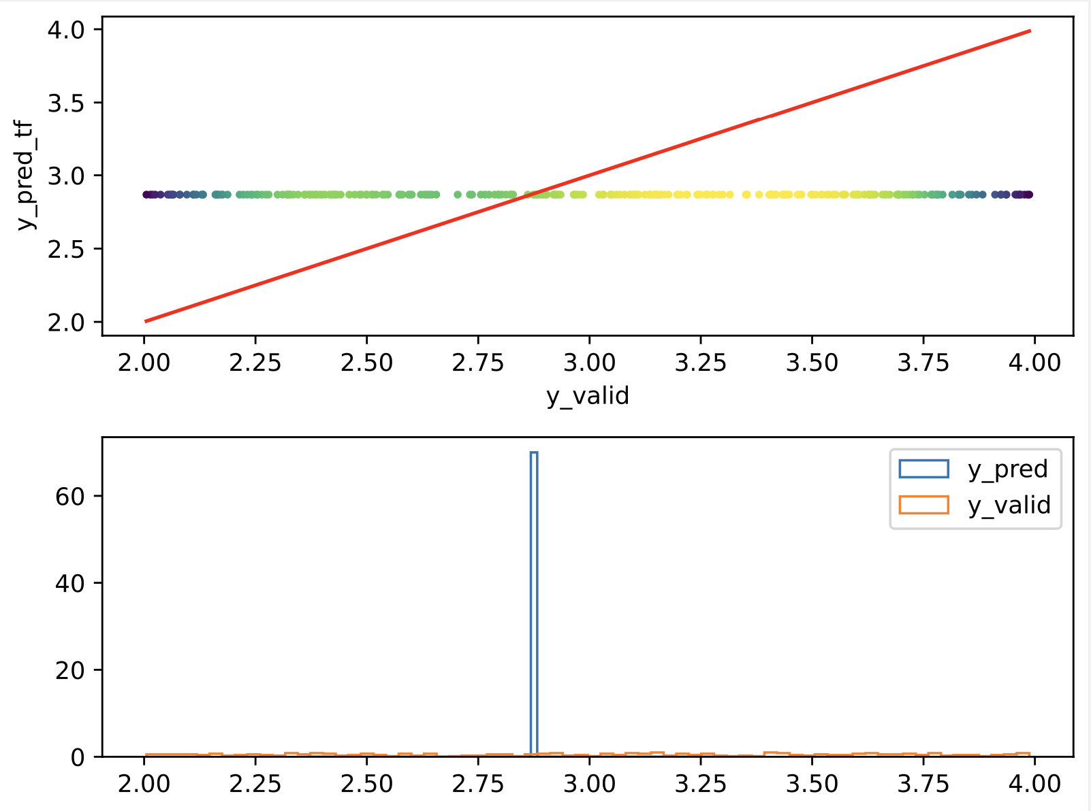
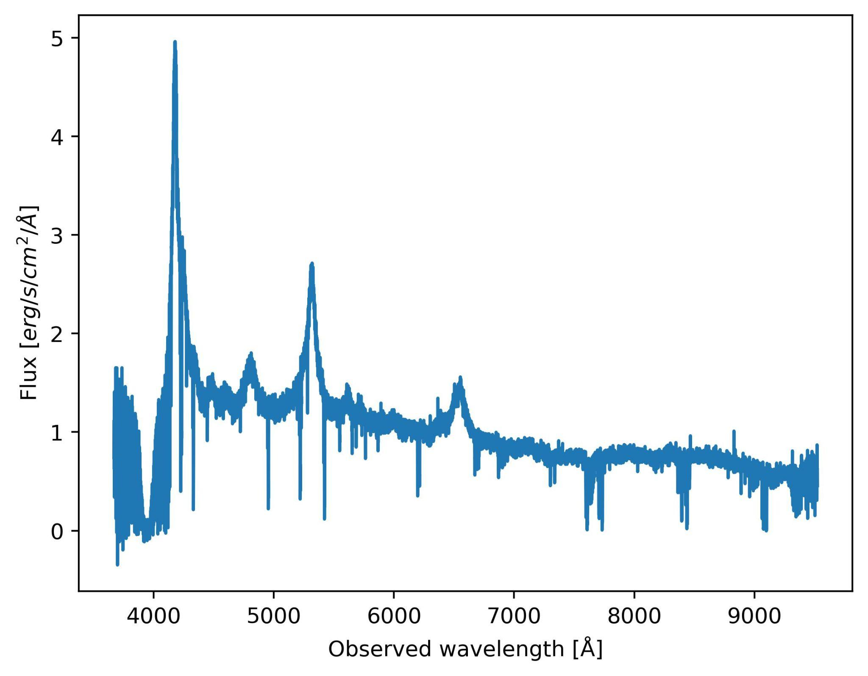
Appendix - GRU
Before:
(~ 1e-16)
Preprocessing is very necessary:
Before:
Flux/mean(Flux)
After:
(~ 1)

Slide 35
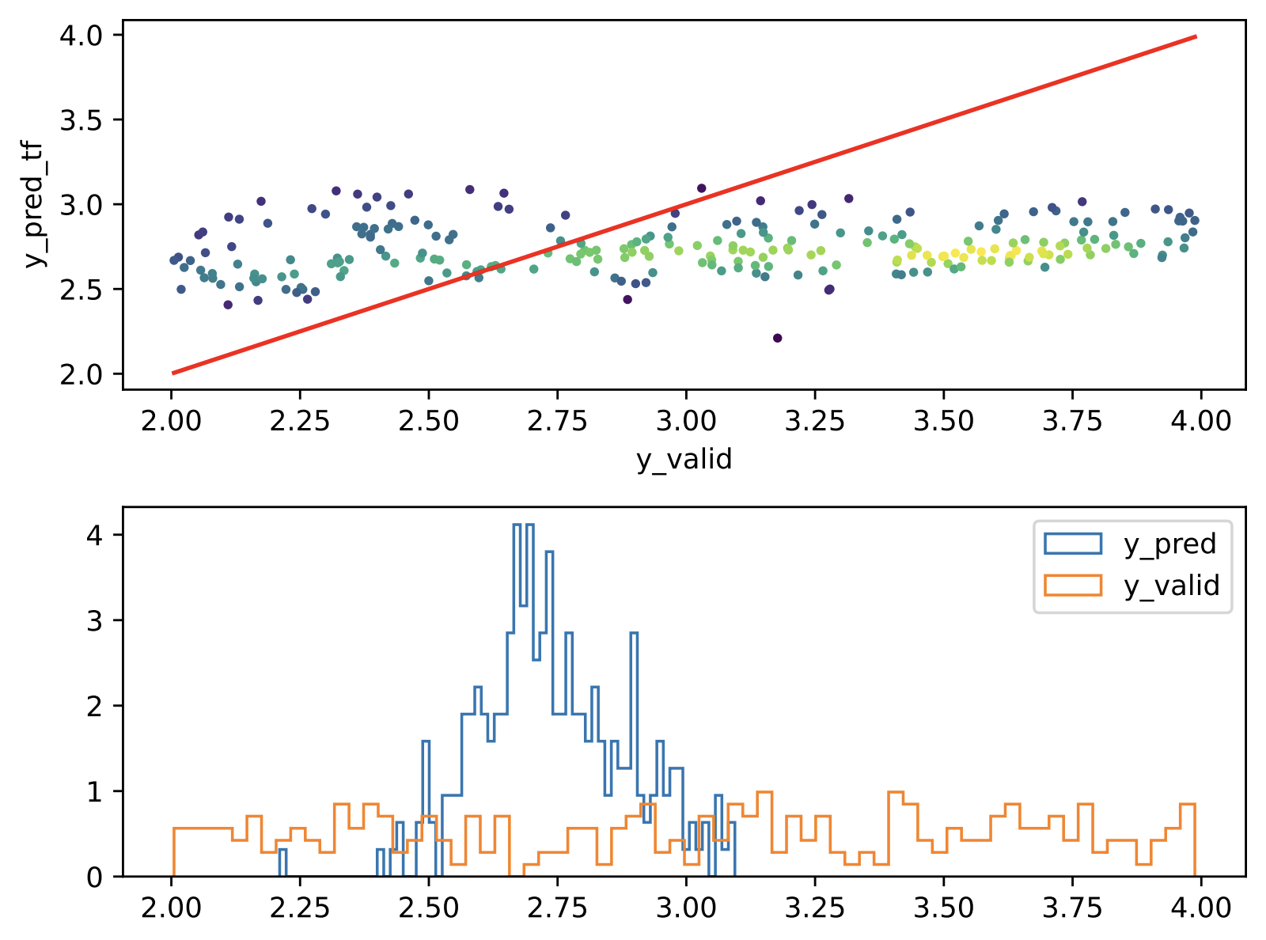
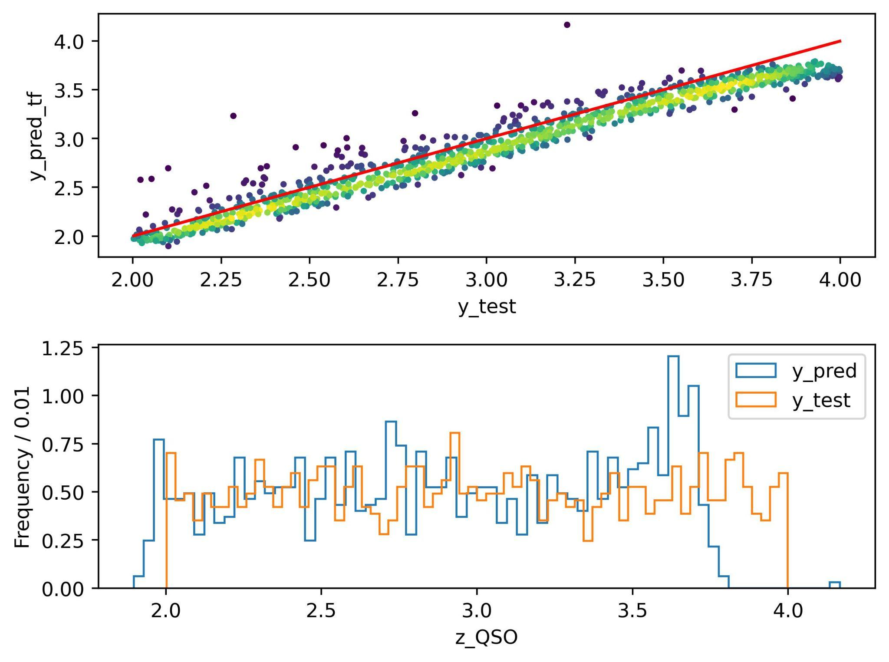
Appendix - GRU
Can improve significantly with larger sample size:
With using 1000 samples to train:
With using 4000 samples to train:

Slide 36
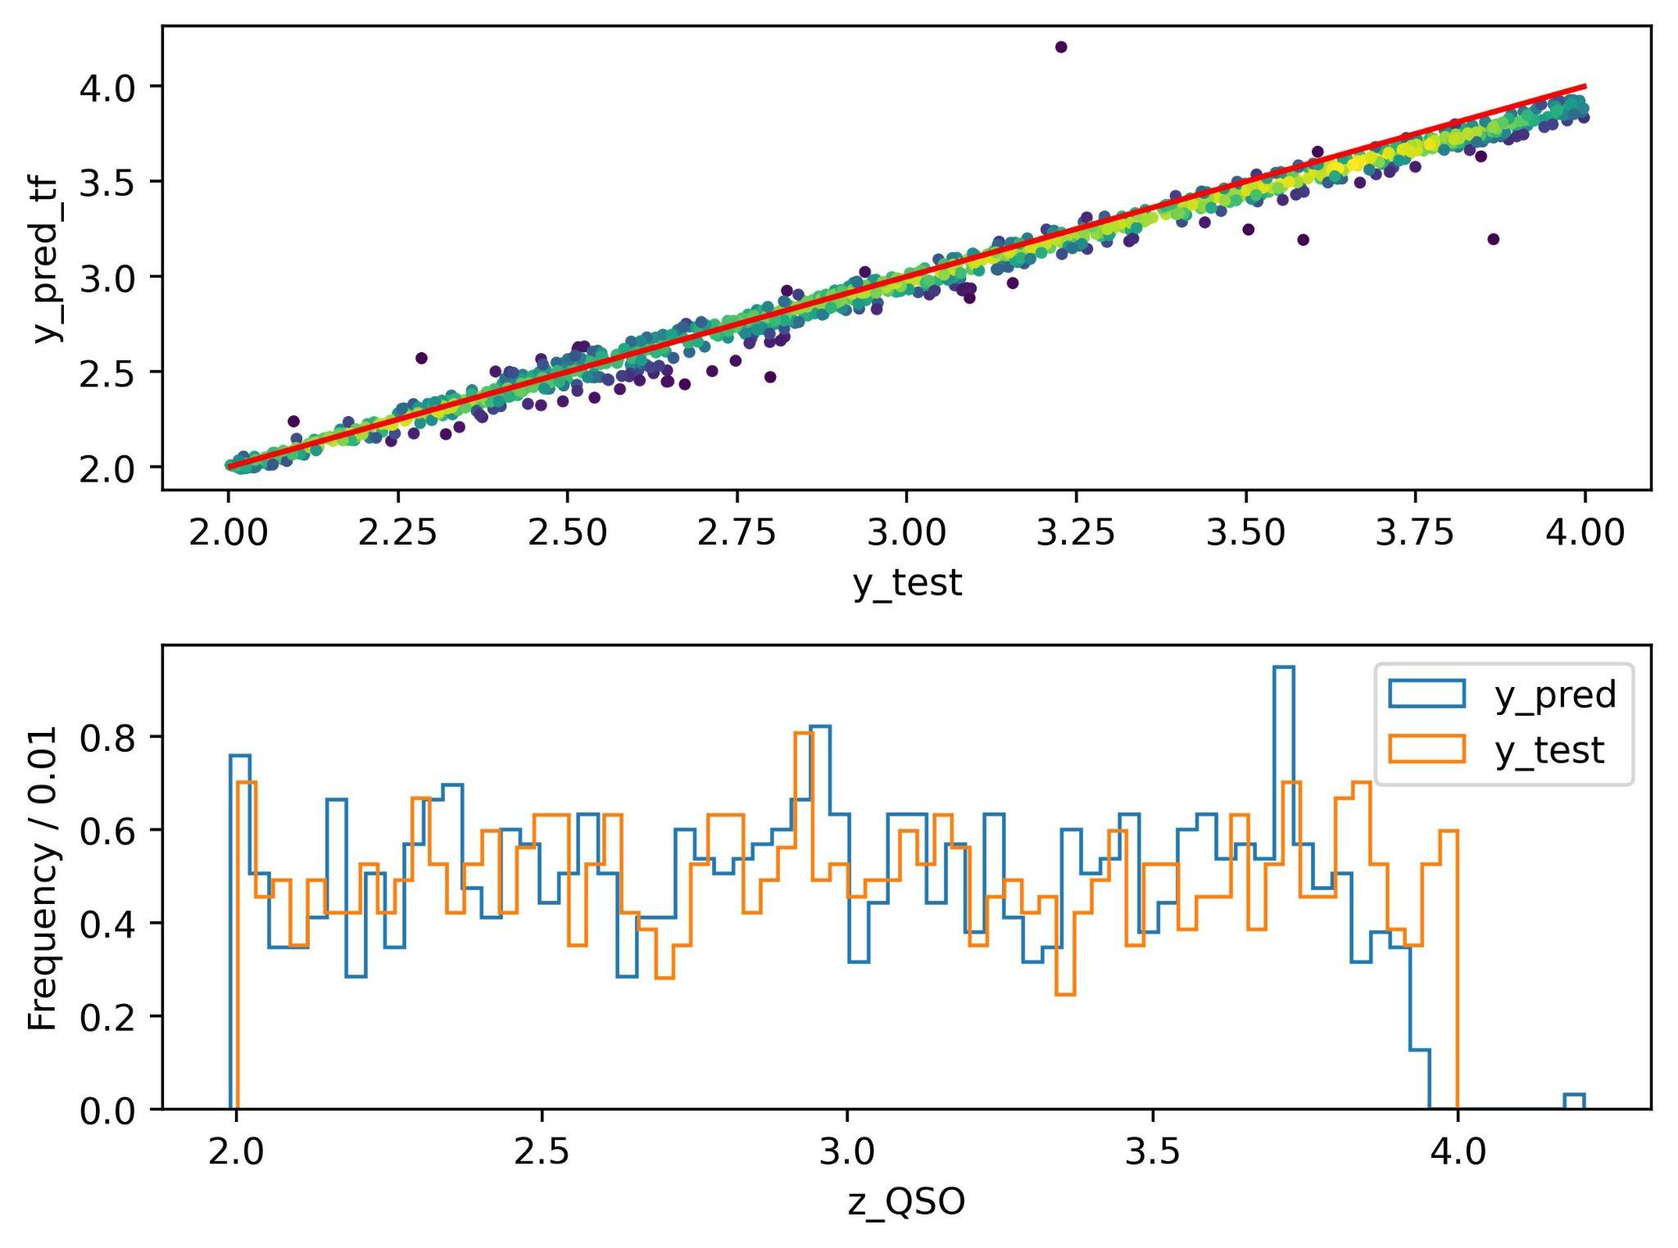
Appendix - GRU
Can improve significantly with larger sample size:
With using 8000 samples to train:
With using 10000 samples to train:

Slide 37
Appendix - CNN classifying DLAs
Preprocessing the data:
The flux value can be too small for computer to recognize and instead of extracting the features from the spectra image, we use an one dimensional array, so we have to normalize the data.
Transform the wavelength into pixels, the dataset size would increase and we can use human knowledge of where DLAs approximately appear to select a sub dataset which will save memory and raise efficiency.

Slide 38
Appendix - CNN Locating DLAs
Reasons for choosing CNN:
Convolutional NNs used for analysing images and visual features
Spectra are basically 1D images, and we’re looking for a specific visual feature (DLAs)

Slide 39
Appendix - CNN Locating DLAs
Preprocessing data:
We know that DLAs only show up between a given range of wavelength, so we could reduce the size of the data down to what was more important (not necessarily too useful for my method but decreased the amount of segments I had to create)
Normalising the data was very helpful, especially normalising the flux to give the relative flux
Reduced the effect of noise by using the rolling medium for each spectra (improved the CNN’s accuracy)
For the input data, made sure to balance the number of true and false segments as to avoid the model from just training to output “0” (as number of segments w/o DLA >>> number of segments with DLA)
Using the segment method gave 10 000 segments w/ DLAs and then we took 10 000 without, for a total of 20 000 in the input data (split into train/val/test etc.)

Slide 40
Appendix - CNN Locating DLAs
Hyperparameter Optimisation:
Used a learning rate scheduler, as I noticed after ~epoch 3 the accuracy and validation accuracy started diverging (overtraining)
Also implemented early stopping, but I was too lenient on the patience as the model starts to overtrain a little near the end
Important hyperparameters were the learning rate (of course), the segment size and the overlap between each segment. I think that the labelling process (how many “1” values in a segment to label the entire segment “1”) as well as the range of what I consider the DLA is also an important hyperparameter
Found that using a larger kernel for the input layer helped
Played with the size of the Conv1D filters to get a good result without too long a run time or significant overfitting

Slide 41
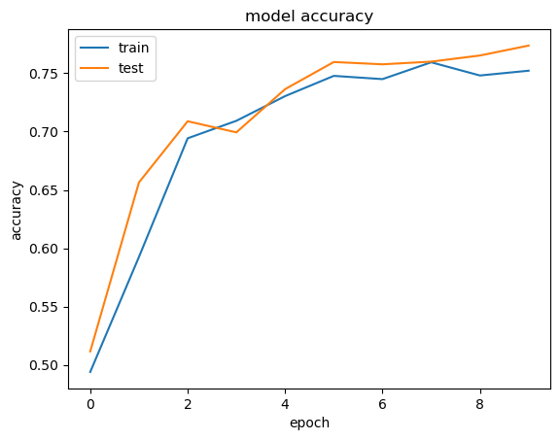
Appendix - CNN Locating DLAs
Batch Normalisation was very important! This + normalising the data improved the accuracy a lot
Accuracy of previous model where these were not applied. Accuracy improved by ~10% in the final model, and loss improved significantly also

Slide 42
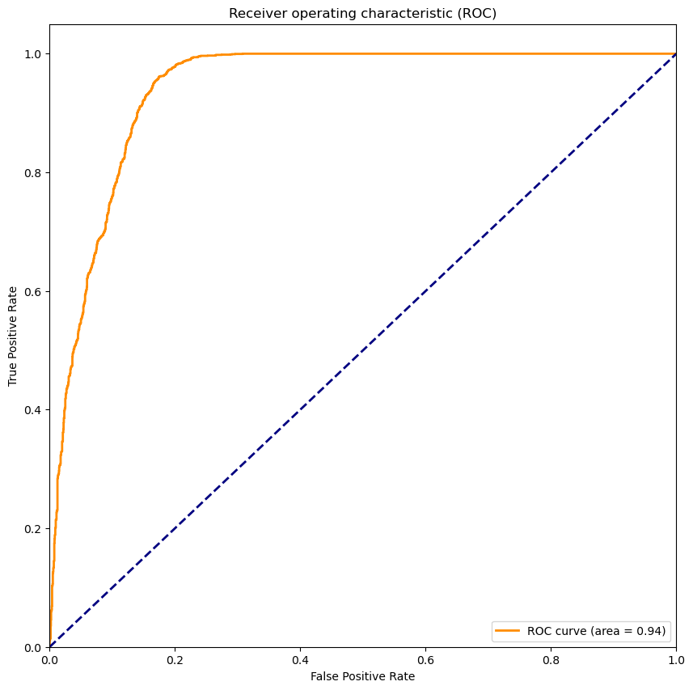
Appendix - CNN Locating DLAs
ROC curve shows that a lot of false positives - means that other absorptions are being falsely flagged as DLAs. could build categorical classifier or exempt these absorptions from segment data to account for this

Slide 43
Appendix - CNN Locating DLAs
Further improvements:
Could have used regression to find the location of the DLA inside the detected segment (e.g. +/- the width of the segment) = more accurate, rather than just looking at the range of the DLA segments and estimating an average - this would reduce the error in the final value of redshift calculated
Would have liked to experiment with the hyperparameters more, and try to optimise them. Was not feasible to do a lot of systematic optimization with the time left due to long runtimes
Could have accounted for other absorptions, which probably would have improved the accuracy as these are somewhat similar to the DLA absorptions and most likely were a source of false positives
Could have tried to use an autoencoder perhaps? (tried to implement one to denoise the spectra since I thought that would be interesting, but then I realised I could just apply the rolling median to basically get the same effect)
Potentially use weight decay with AdamW?

